Slide 1


Docker
GSG Missing Semester Boot Camp

Slide 2

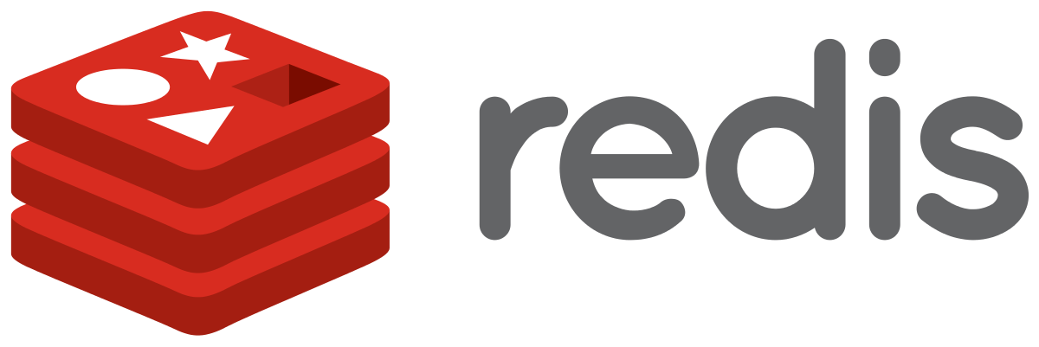

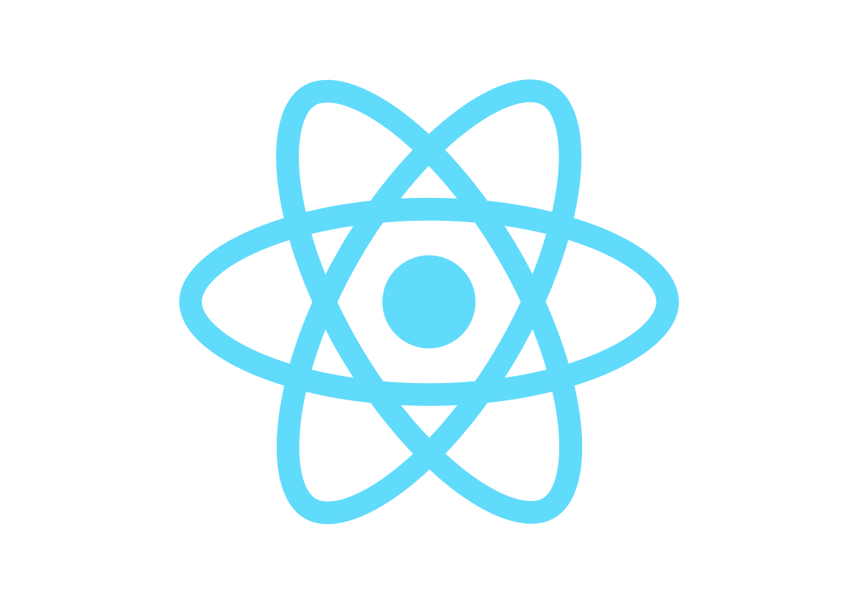

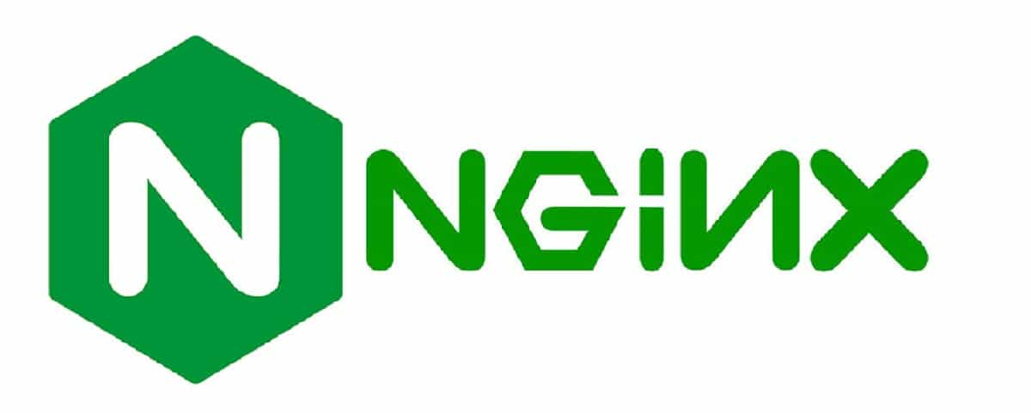
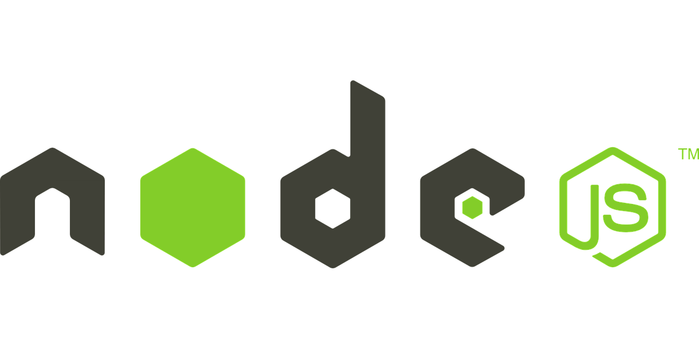
Problem
Each Project relies on many dependencies.

Slide 3
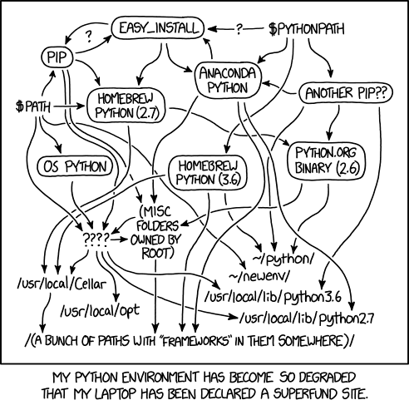
Problem
Clashing Tools / Versions between different projects
Dependencies are hard to manage.

Slide 4




Problem
Configuration is repeated on each device, perhaps with different steps.
Different development environments within a team / company

Slide 5
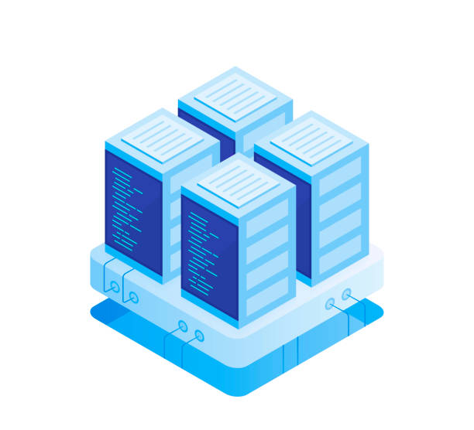

Problem
Development
Testing
Production

Slide 6
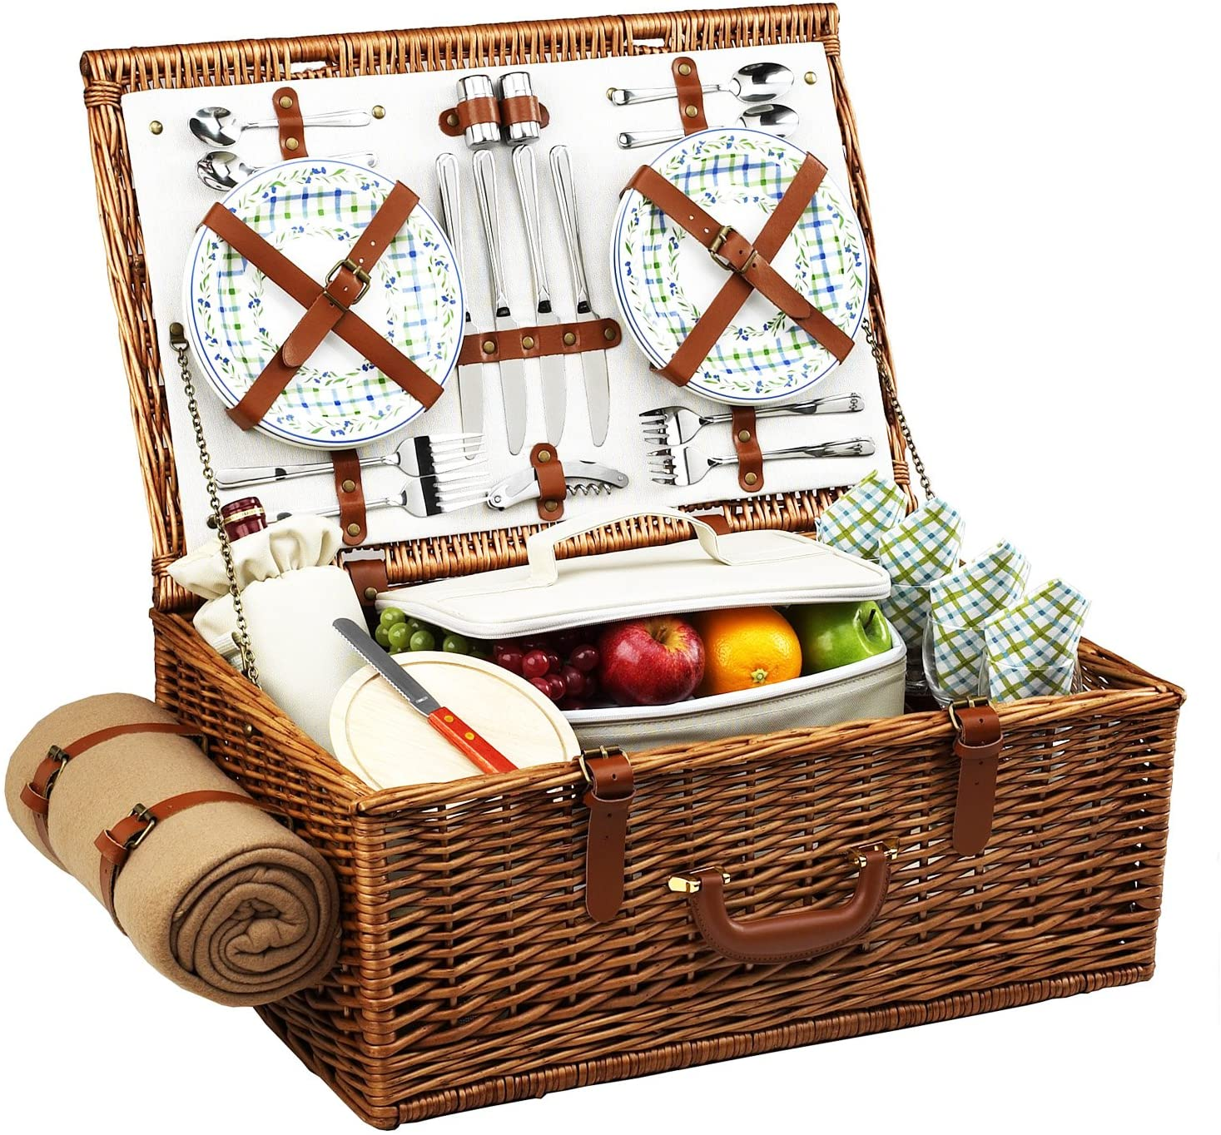
Illustration example
Dishes
Food
A Picnic Basket

Slide 7
Illustration example
It’s portable
You can share it and use it everywhere
It contains food and dishes

Slide 8



Illustration example

Slide 9
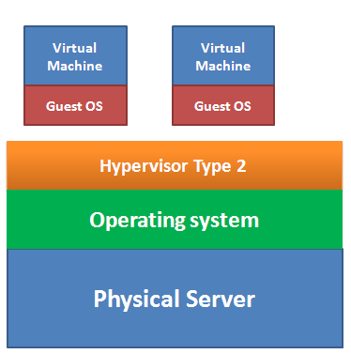
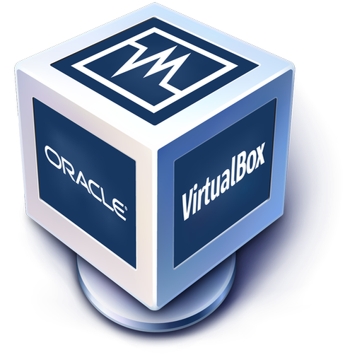
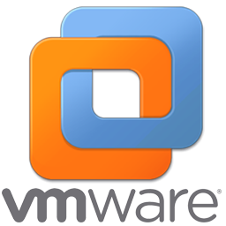
Solution
Virtual Machines

Slide 10
Linux
Application
Remember that all linux distributions share the same kernel.
Shell
Kernel
Library Routines

Slide 11
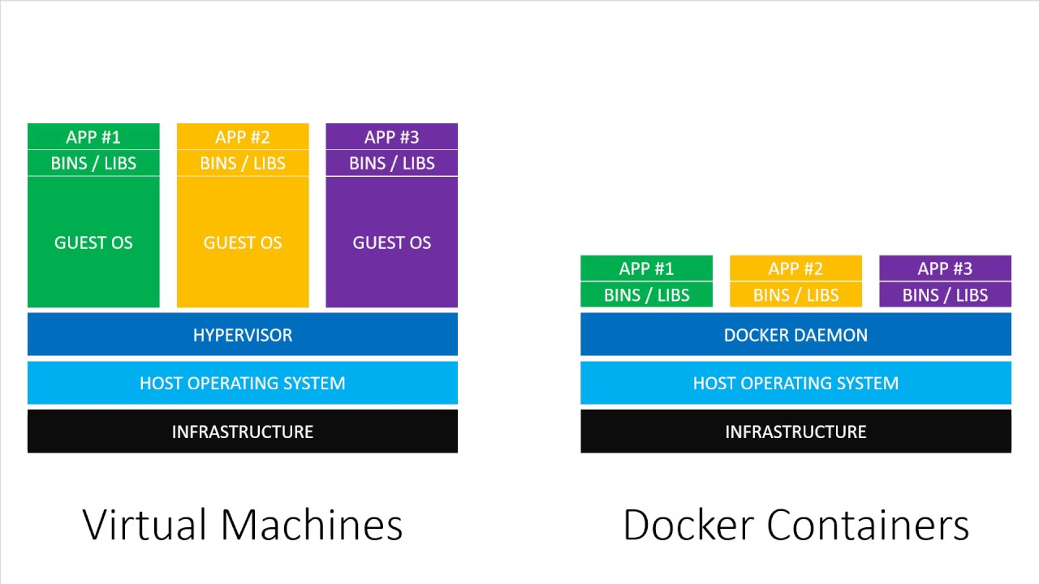
Docker VS VMs

Slide 12
Docker VS VMs
Docker Containers
Virtual Machines
Low impact on OS, very fast,
minimal disk space usage
Bigger impact on OS, slower,
higher disk space usage
Sharing, re-building and
distribution is easy
Sharing, re-building and
distribution can be challenging
Encapsulate apps/ environments
instead of “whole machines”
Encapsulate “whole machines”
instead of just apps/ environments

Slide 13
First Docker Application
Run the following commands
docker pull ramisalman/gsg-meme
docker container run --publish 8080:80 ramisalman/gsg-meme

Slide 14
Docker Architecture
Container
Image
Registry

Slide 15
Docker Image
Images are multi-layered self-contained files that act as the template for creating containers. They are like a frozen, read-only copy of a container.
Image
uname -a
NodeJS App Code
docker run alpine uname -a
NodeJS Environment

Slide 16
Docker Images
Running NodeJS App
Running NodeJS App
Running NodeJS App
A Docker container is a runtime instance of a Docker image that gets created when the $ docker run command is implemented
Image
NodeJS App Code
NodeJS Environment

Slide 17
Docker Registry
A docker registry is a centralized place where you can upload your images and can also download images created by others.
Docker Hub

Slide 18
Docker Engine
The engine consists of three major components:
1- Docker Daemon: The daemon (dockerd) is a process that keeps running in the background and waits for commands from the client.
2- Docker Client: The client (docker) is a command-line interface program mostly responsible for transporting commands issued by users.
2- REST API: The REST API acts as a bridge between the daemon and the client.

Slide 19
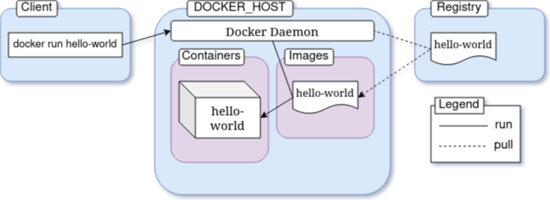
Docker Engine
docker run hello-world

Slide 20
Basic commands
Create and Start a container
docker run
List all the running containers.
docker ps (-a) / docker container ls

Slide 21
Publishing The Application Port
Containers are isolated environments. Your host system doesn't know anything about what's going on inside a container.
To allow access from outside of a container, you must publish the appropriate port inside the container to a port on your local network.
--publish <host port>:<container port>
docker container run --publish 8080:80 ramisalman/gsg-meme

Slide 22
react => 80

Slide 23
Detach Mode
By default, containers run in the foreground and attach themselves to the terminal like any other normal program invoked from the terminal.
In order to override this behavior and keep a container running in background, you can include the --detach option with the run command
--detach
docker container run --detach --publish 8080:80 ramisalman/gsg-meme

Slide 24
Containers Names
By default, every container has two identifiers. They are as follows:
CONTAINER ID - a random 64 character-long string.
NAME - combination of two random words, joined with an underscore.
--name
docker container run --detach --publish 8888:80 --name hello-dock-container ramisalman/gsg-meme

Slide 25
Containers Commands
Rename an old container
docker container rename <container identifier> <new name>
Stop a running container
docker container stop <container identifier>
docker container kill <container identifier>

Slide 26
Containers Commands
Create a container without running
docker container create --publish 8080:80 ramisalman/gsg-meme
Start a container
docker container start container-name

Slide 27
Containers Commands
Remove a container
docker container rm <container identifier>
--rm indicate that a container will be automatically removed after it stops.
docker container run --rm --detach --publish 8888:80 --name hello-dock-volatile ramisalman/gsg-meme

Slide 28
Basic commands
Container are not made to host an OS. It’s made to run a process. If the web server stopped then the container will stop.
docker run ubuntu

Slide 29
Interactive Mode
Usually we need to interact with the container
-i --interactive option connects you to the input stream of the container, so that you can send inputs to bash.
-t --tty option makes sure that you get some good formatting and a native terminal-like experience by allocating a pseudo-tty.
docker container run --rm -it ubuntu

Slide 30
docker pull image_name
docker run
image
code + env
it’s working !
image
code + env

Slide 31
exec vs run
docker container run --rm -it ubuntu
docker exec -it container_name bash
exec run commands on a running container.
run is used to run the command.

Slide 32
CMD VS ENTRYPOINT VS RUN
touch Dockerfile
nano Dockerfile
$$$$$$$$$$
FROM ubuntu
RUN apt update
ENTRYPOINT echo hi
$$$$$$$$$
docker build . -t ahmad
docker container run ahmad

Slide 33
Building our own Docker File
Dockerize your own application
Enter the folder and create a file called Dockerfile and paste the following code.
FROM node:7.10
WORKDIR /usr/app
COPY . ./
RUN npm install
EXPOSE 3000
ENTRYPOINT npm start

Slide 34
Building our own Docker File
Dockerize your own application
Enter the folder and create a file called Dockerfile and paste the following code.
FROM node:7.10
WORKDIR /usr/app
COPY . ./
RUN npm install
EXPOSE 3000
ENTRYPOINT npm start

Slide 35
Building our own Docker File
Build you own docker image.
docker build -t getting-started .
Run the image using the following command
docker run -d -p 3000:3000 getting-started

Slide 36
Docker Compose
Compose is a tool for defining and running multi-container Docker applications. With Compose, you use a YAML file to configure your application’s services.

Slide 37
Docker Compose
Use the following link and clone the repo:
Open anyone of the projects and run the following
docker-compose up

Slide 38
Second Docker Application
Create a file called docker-compose.yml and paste the following inside it:
version: '3.1'
services:
db:
image: mysql
restart: always
environment:
MYSQL_ROOT_PASSWORD: root
MYSQL_DATABASE: gsg
ports:
- "3307:3306"
volumes:
- $HOME/Desktop/MySQL-Snippets/school.sql:/school.sql

Slide 39
Second Docker Application
Enter the directory where you placed your docker-compose file and run the following:
docker-compose up
List the running containers on your device
docker ps

Slide 40
Second Docker Application
Run the following commands
docker exec -it mysql_db_1 bash
Connect to the database
mysql -uroot -proot

Slide 41
Second Docker Application
Enter the database you have created.
USE gsg
List the tables inside the database
SHOW TABLES;
Create a table
CREATE TABLE pet (name VARCHAR(20), owner VARCHAR(20),
species VARCHAR(20), sex CHAR(1), birth DATE, death DATE);

